Slide 1
Accuracy analysis using Fashion MNIST dataset
SUMMER INTERNSHIP PROGRAM
Team Name-
Code Avengers
Team Members:
K. SAI KUMAR
D. AKHIL KUMAR
Y.PAVAN KUMAR
CH.HARI PRIYA
G.SUNIL KUMAR
Submitted to:
Miss. Deepika

Slide 2
Introduction:
In this project we are going to calculate Accuracy and losses of Fashion Mnist dataset using Neural Networks.
We use python for get the accuracy and loss.
Convolutional Neural Networks and Artificial Neural Network were designed to map image data to an output variable.
They have proven so effective that they are the go-to method for any type of prediction problem involving image data as an input.

Slide 3
Objective:
The Fashion MNIST training set contains 60,000 examples, and the test set contains 10,000 examples.
The main goal of Fashion MNIST is to serve as a drop-in replacement for the original MNIST.
To fit the dataset into the best model.
To predict which classification the input given by the user belongs to
Finally to make the user-interface for easy use of the application

Slide 4
Technologies Used:
Operating System: Artificial Intelligence is platform Independent, it can be accessed on Android, Windows ,Linux or any other OS the user wishes to open.
Programming Languages: Python
Tools: The tools used to create the project is:
Jupyter Notebook
Anaconda Navigator
Packages:
Tensorflow
Keras
Matplotlib
Numpy

Slide 5
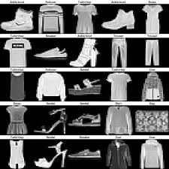
Data Set
We use a dataset containing different fashion images
In this dataset contains 10 types of fashion products
The ten fashion class labels are
T-shirt/top
Trouser/pants
Pullover shirt
Dress
Coat
Sandal
Shirt
Sneaker
Bag
Ankle boot

Slide 6
Methodology
A Neural Network is a network or circuit of neurons, or in a modern sense, an artificial neural network,
composed of artificial neurons or nodes for solving Artificial Intelligence (AI) problems.
The layers used in the data modelling are
Convolutional layer
Pooling layers
Fully connected layers

Slide 7

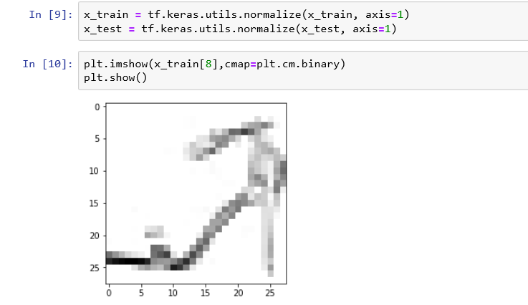
Process Loading the Fashion Mnist dataset and display the image

Slide 8
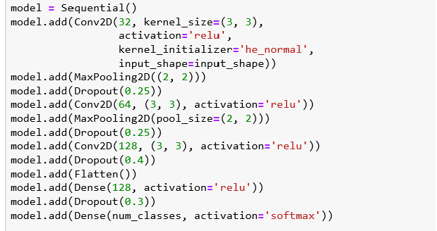
Building The Convolutional Neural Networks

Slide 9
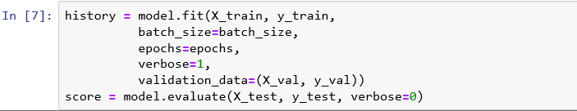
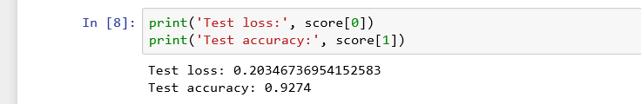
Compiling,Fitting and Evaluating the Model

Slide 10
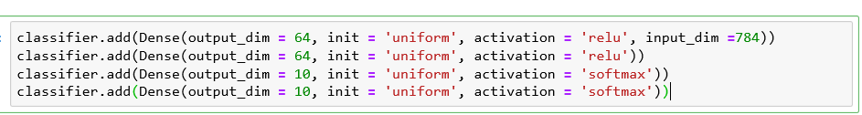
Building The Artificial Neural Networks

Slide 11
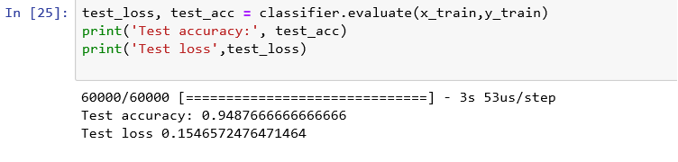
Compiling,Fitting and Evaluating the Model

Slide 12
Conclusion
In this model we are close enough to successfully predict the quality of fashion Mnist dataset.
We got accuracy of 94.87% with ANN and 92.74% with CNN that can be predict the 100% Accuracy.
Artificial Intellegence overall is very powerful tool to revolutionize the way things work.
So finally we conclude that Artificial Neural Network is best way to predict the fashion Mnist dataset.

Slide 13
Thank You
Presented By
Code Avengers.

